Slide 1
Movie Recommendation System
Under the guidance of Prof. Supriya Mohite
Department of Information Technology
STES's Sinhgad College of Engineering Vadgaon (Bk.)
Paper ID- ICPC2020/13/75

Slide 2
Contents
1. Title
2. Purpose , Scope, Objectives
3. Abstract
4. Introduction (Architecture and High-level Design)
5. Literature Survey
6.Methodology
7.Design/algorithms/techniques used
8.Proposed System
6. References
7. Project Plan 1.0

Slide 3
Purpose
The main purpose behind building the movie recommendation system is that to build a software that will recommend movies to the users effectively and in a time efficient manner according to there taste of movies so as to enhance there movie viewing experience and hence they do not end up wasting there time in searching or watching movies they may not like (“most probably”) and also create a platform for content creators to showcase there talent and find global audience.

Slide 4
Scope of the Project
Recommender System is a system that seeks to predict or filter preferences according to the user’s choices. They help reduce information overload and provide customized information access for targeted domains. Recommender systems open new opportunities of retrieving personalized information on the Internet.
It also helps alleviate the problem of information overload which is a very common phenomenon with information retrieval systems and enables users to have access to products and services which are not readily available to users on the system. Helps in collecting authentic data with improved accuracy and makes the system more responsive.

Slide 5
Objectives
To build a robust movie recommendation system which will recommend movies to it's user based on there interest of movies.
To incorporate opinion mining to improve the performance of the recommendation system.
To improve the efficiency of the recommendation system by the conglomeration friend’s recommendation .

Slide 6
Abstract
Personalized customer service can set your business apart. Personalization is a means of meeting the customer's needs more effectively and efficiently making interactions faster and easier and consequently, increasing customer satisfaction.
The movie recommendation system implemented in our project is based on the collaborative filtering algorithm along with matrix factorization method. However we are using opinion mining to incorporate the user's opinion at the fine-grained level to improve the prediction accuracy of recommendation system.

Slide 7
Literature Survey
Sr. No. | Reference Name (Write Paper Title) | Seed Idea/ Work description | Pros | Cons
1 | Improving the accuracy of collaborative filtering recommendations using clustering and association rules mining on implicit data | To improve the results provided by the traditional recommendation system by employing association rules mining. | Achieves better performance when compared to the basic CF and other extended version of CF techniques in terms of Precision, Recall metrics, even when the data is very sparse. | A lot of steps required to achieve the actual sentiment.
2 | Analysis of Algorithms Used in Opinion Mining | Types of algorithm used in opinion mining. Challenge the decision making problem good or bad. | Classifies the polarity of a given text. Supervised & Unsupervised Algorithmns. | A lot of steps required to achieve the actual sentiment.
Source and Year
Sicence Direct 2017
IEEE 2017

Slide 8
3 | Collaborative Filtering Recommender Systems | How to develop collaborative filtering algorithm and how it is used for recommendation | We don’t need domain knowledge because the embeddings are automatically learned | Quantitative data such as product rating or purchase history reflect user’s taste is questionable.
4 | Survey on Opinion Mining Algorithms and Applications | Overview of Opinion mining algorithms and classification with their field of applications. | Positive or negative connotation is mathematically represented as a quintuple. | Information is available in multiple different formats.
5 | Opinion Mining and Analysis of Movie Reviews | Analyzes sentiment from orientation of words in text. Opinion is preprocessed and stored in text file. | Data is compared with a bag of words. Manually defining dictionary. | Utility matrix is sparse as most users do not rate most items
IEEE 2017
IEEE 2016
IEEE 2016

Slide 9
6 | A Content-based Movie Recommender System based on Temporal User Preferences | In this paper, a content-based movie recommender system is proposed that captures the temporal user preferences in user modeling and predicts the preferred movies. | The applications for matrix factorization such as Dimensionality reduction of Data. | Implicit feedback accuracy issues , Quantitative data such as product rating or purchase history reflect user’s taste is questionable
7 | Clustering Recommenders in Collaborative Filtering Using Explicit Trust Information | How problem of data overload has been overcome using clustering algorithms | Clustering allows us to group similar kind of data reducing the complexity in the sparse data. | Sparsity and information over- load problem.
8 | Algorithms for Opinion Mining and Sentiment Analysis: An Overview | Survey of challenges and overview of classification and clustering algorithms for opinion mining. | Multi-class model classes; Efficient classification algorithm; Inexpensive; Robust; Fast evaluation. | Difficult to eliminate spam; Difficult to tackle each language; Difficult to deal with abbreviations.
IEEE 2017
IEEE 2017
IEEE 2015

Slide 10


Proposed System
Front –end Tier
Middle Tier
Back–end Tier
Web Application
Chrome Firefox
Chrome Firefox
Web Server
Database
Django
Movies,
Users,….
Python
Mobile App
User

Slide 11
System Architecture

Slide 12
User Profile
Huge Amount of Movie Data
Prediction algo 1.0.
Prediction algo.
1.1
Association rule mining
Preprocessing
No of k
clusters
Extract Association Rules
Input
Clustered
data
Dist. obj to centroid
Feature Extractor
Predict User’s preference
Categori-zation of data
MLA
Grouping
Based on min dist.
Recommend-ation List
Filtereddata
User
Recommendations

Slide 13
Phase 1
Cluster analysis or clustering is the task of grouping a set of objects in such a way that objects in the same group (called a cluster) are more similar (in some sense or another) to each other than to those in other groups (clusters).

Slide 15
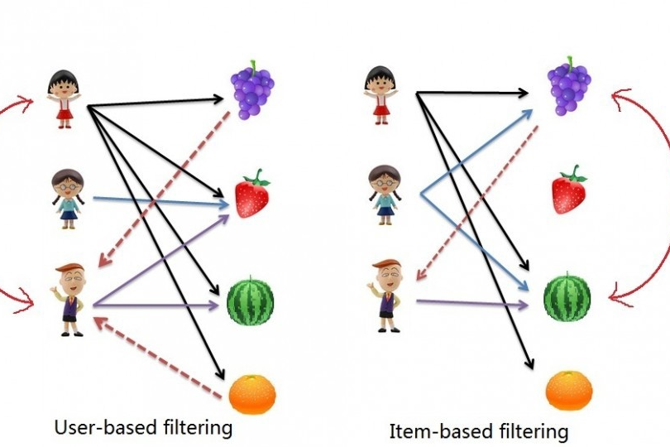
Phase 2.1

Slide 16
There are 2 main types of memory-based collaborative filtering algorithms:
User-User Collaborative Filtering : Here we find look alike users based on similarity and recommend movies which first user’s look-alike has chosen in past.
Item-Item Collaborative Filtering: It is quite similar to previous algorithm, but instead of finding user’s
look-alike, we try finding movie’s look-alike.

Slide 17
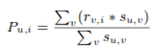
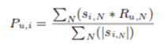
User -user collaborative filtering
Item –item collaborative filtering
Pu,i is the prediction of an item
Rv,i is the rating given by a user v to a movie i
Su,v is the similarity between users

Slide 18
Phase 2.2
Recommendation systems employ the past transactions of users and extract users’ interests to predict users’ preferences.
Past transactions constitute the user proﬁle, Which may contain user demographics data (e.g. age, gender), feedback data (e.g. rating, click), context data (e.g. time and location), and resource features (e.g. keyword vector)
A recommender system helps users to ﬁnd interested resources.

Slide 19
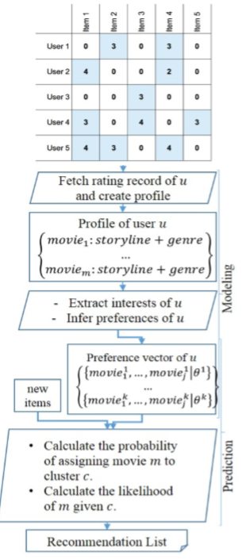
Contents of the Seminar
Working

Slide 20

Phase 3
Emotion associated with Genre of Movie :
8 classes of emotion :
‘Anger’, ‘Anticipation’, ‘Disgust’, ‘Fear’, ‘Joy’, ‘Sad’, ‘Surprise’, ‘Trust’.
Corresponding movies are displayed for the emotion :
Project Title Goes here

Slide 21
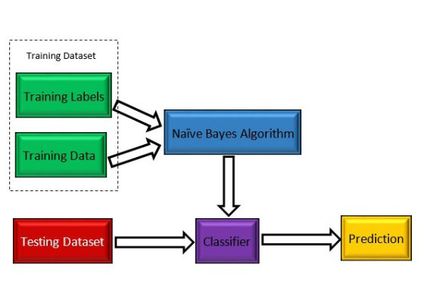
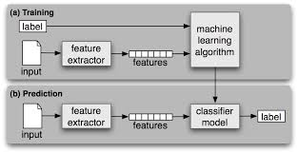
Algorithms used for Opinion Mining
A) Classification
1). Naive Bayes Classifier :
Applications-
Categorization of news
Email spam detection
Face Recognition

Slide 22
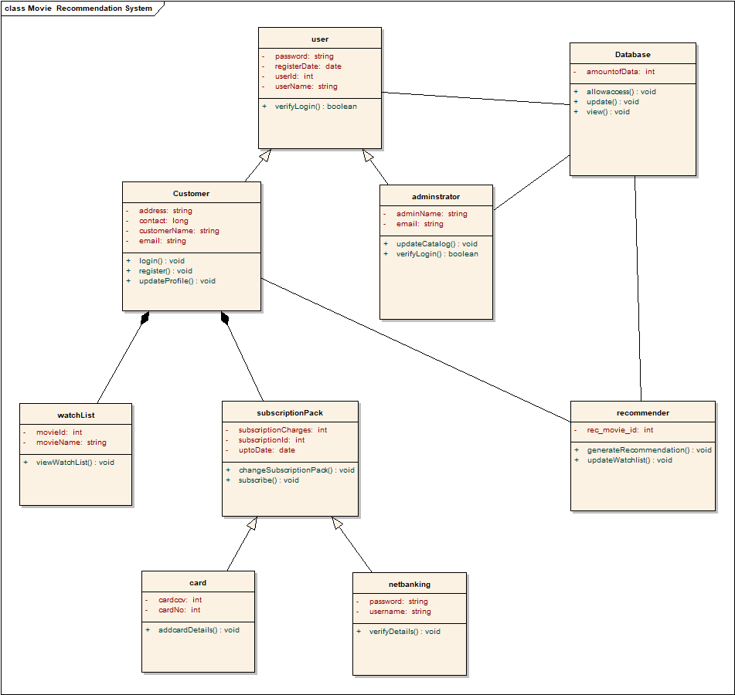
CLASS DIAGRAM

Slide 23
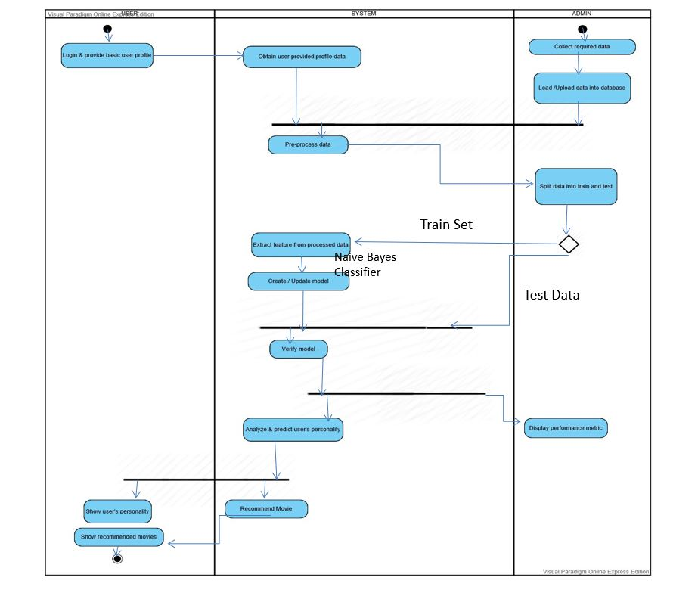
ACTIVITY DIAGRAM

Slide 24
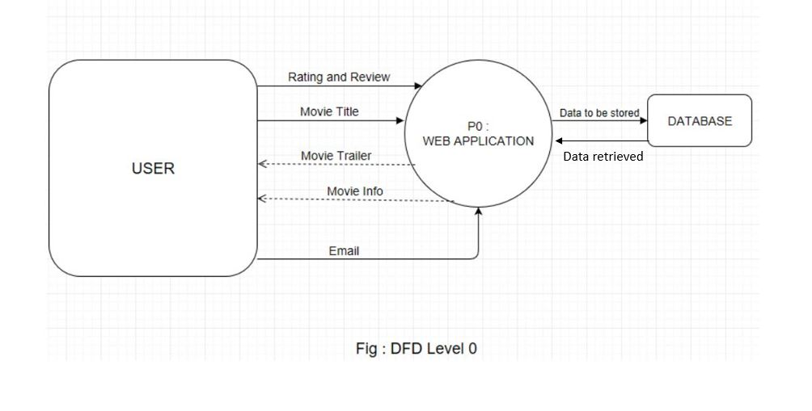
DATAFLOW 0

Slide 25
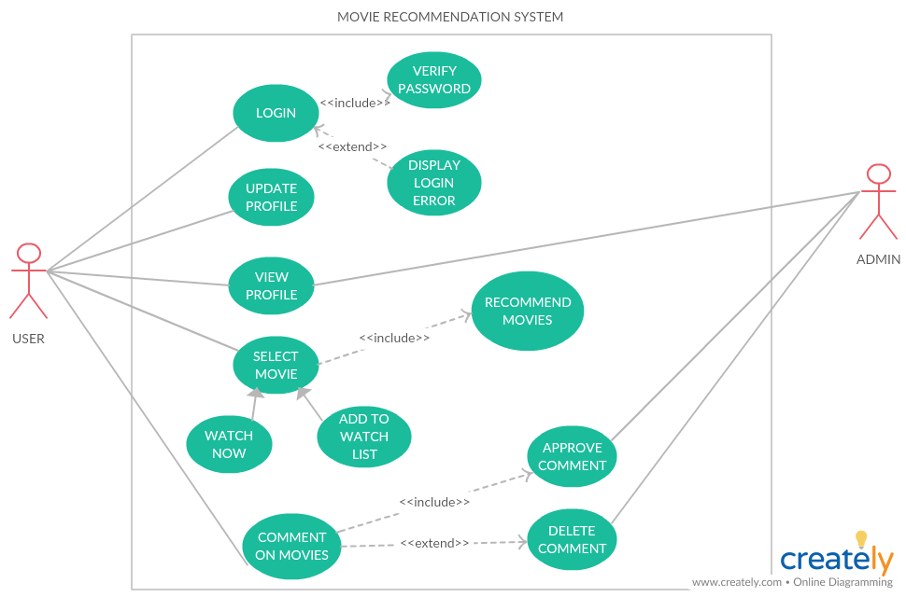
USE CASE DIAGRAM

Slide 26
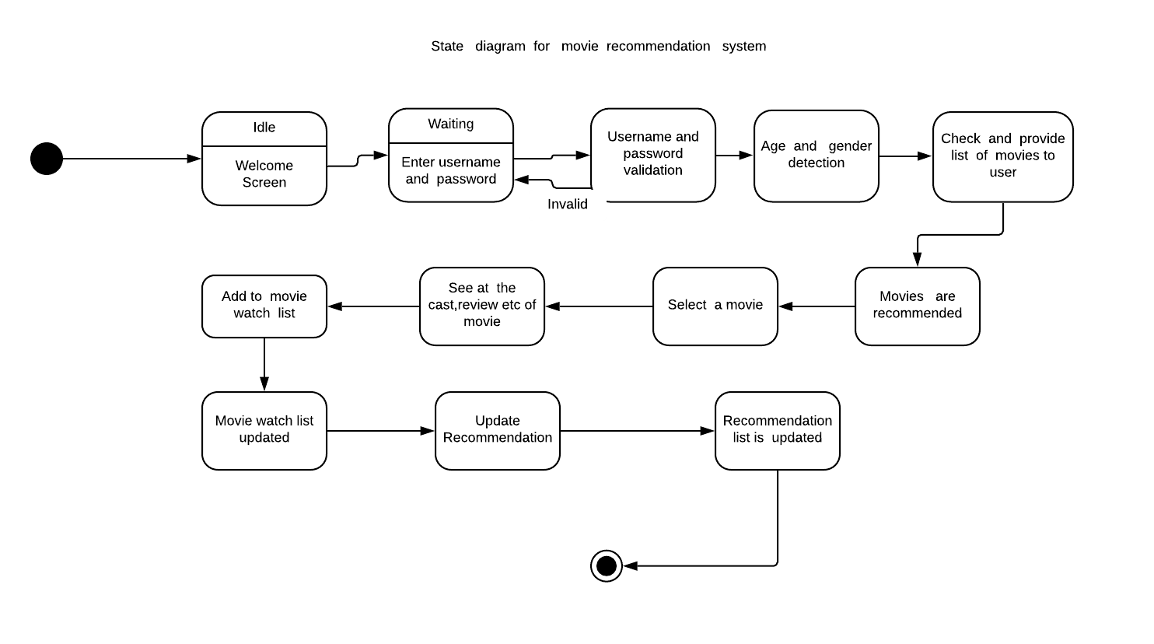
STATE DIAGRAM

Slide 27
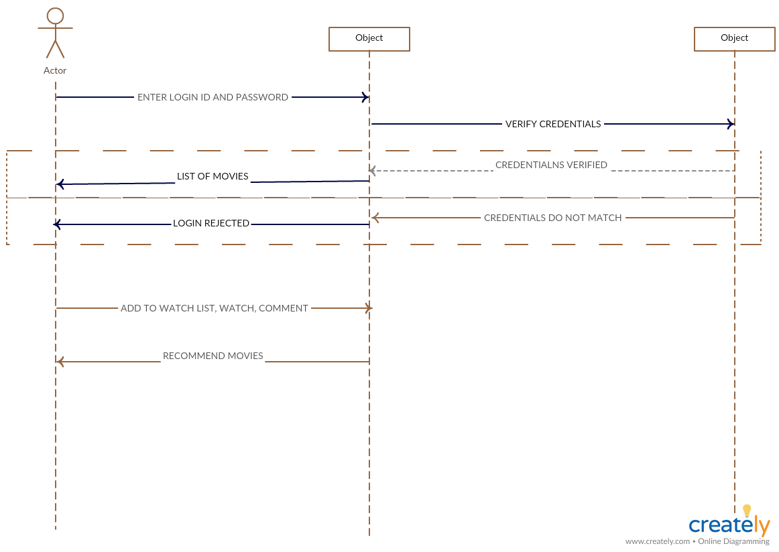
SEQUENCE DIAGRAM

Slide 28
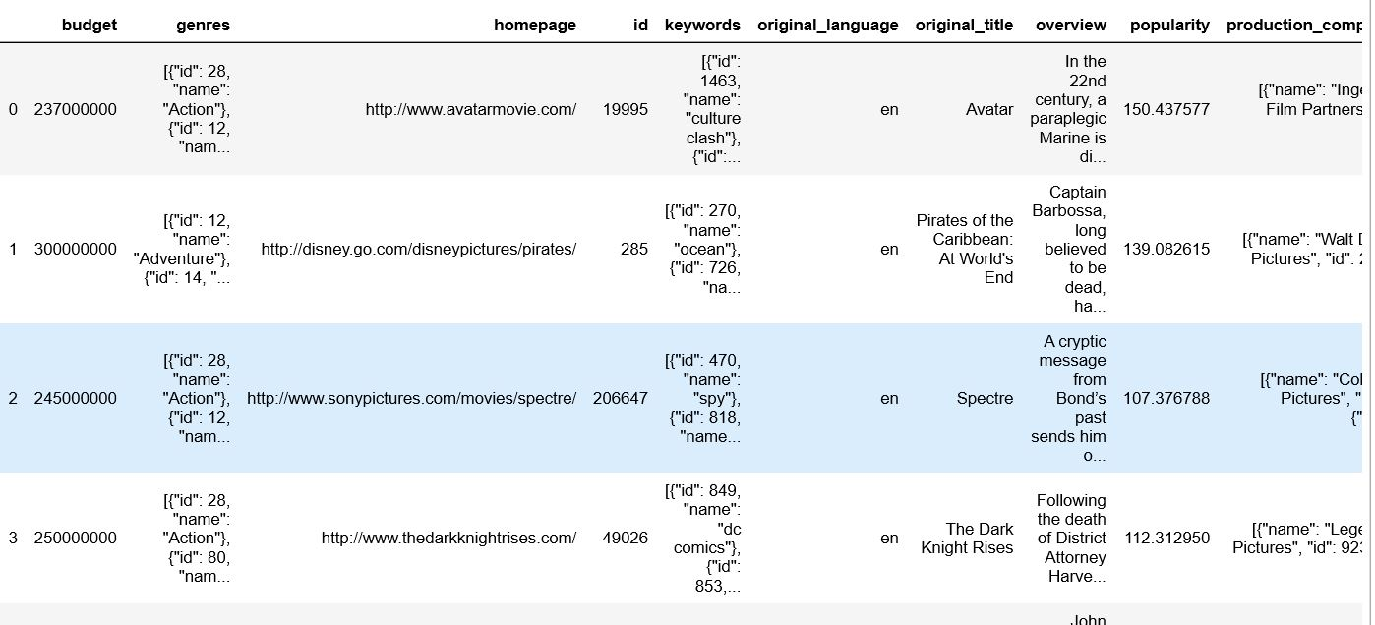
#Two data sets names credits and movies are merged together for optimization.
1. credits_column_renamed=credits.rename(index=str,columns={"movie_id":"id"})
movies_df_merge=movies_df.merge(credits_column_renamed,on='id')
movies_df_merge.head()

Slide 29
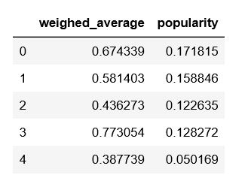
#The data is normalised to reduce redundancy and dependancy of data.
2. from sklearn.preprocessing import MinMaxScaler
scaling =MinMaxScaler()
movie_scaled_df=scaling.fit_transform(movies_cleaned_df[['weighted_average','popularity']])
movie_normalized_df=pd.DataFrame(movie_scaled_df,columns=['weighed_average','popularity'])
movie_normalized_df.head()

Slide 30
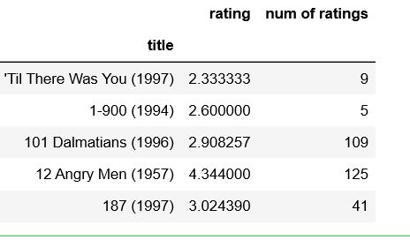
#The number of ratings given by various users is generated
3. ratings['num of ratings’]=pd.DataFrame(df.groupby('title')['rating'].count())
ratings.head()

Slide 31
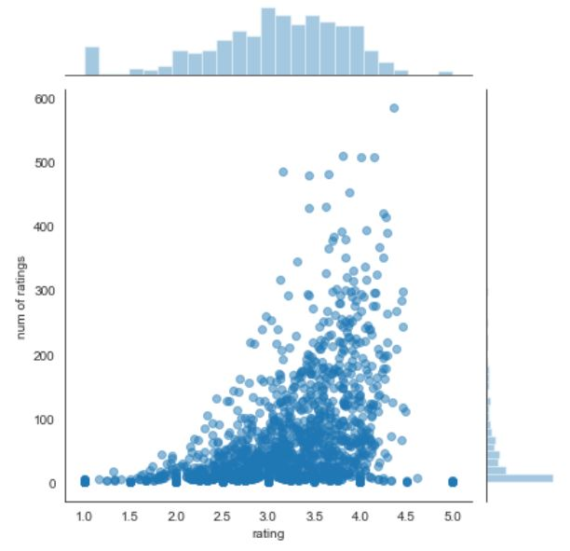
#Further the ratings and number of ratings provided by users are plotted on the graph.
4. sns.jointplot(x='rating',y='num of ratings',data=ratings,alpha=0.5)

Slide 32
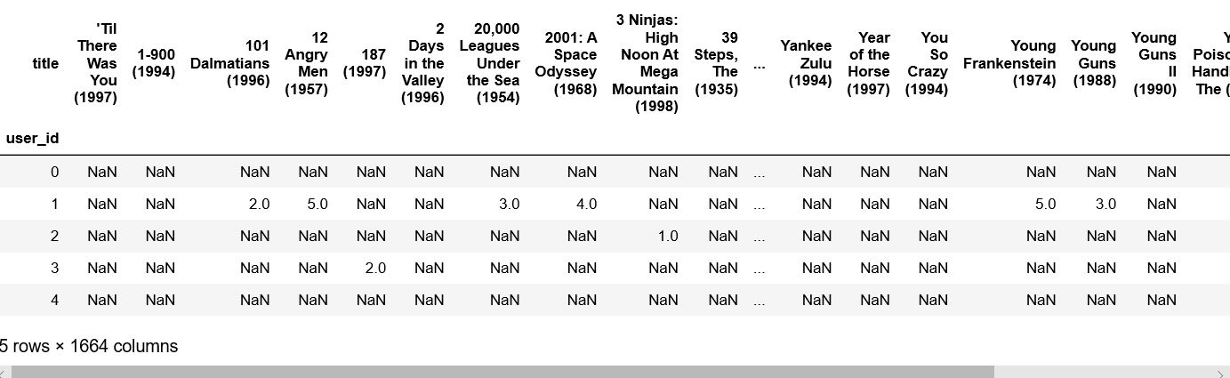
#Pivot Table plays an important role and tells us about the ratings given by the users to films. Using this we can find the highest or lowest rated films. This data further helps to recommend movies to users.
5. pivot table
moviemat=df.pivot_table(index='user_id',columns='title',values='rating')
moviemat.head()

Slide 33
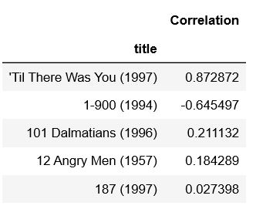
#Now using correlation function similar movies are found out
6.similar_to_starwars=moviemat.corrwith(starwars_user_ratings)
corr_starwars=pd.DataFrame(similar_to_starwars,columns=['Correlation'])
corr_starwars.dropna(inplace=True)
corr_starwars.head()

Slide 34
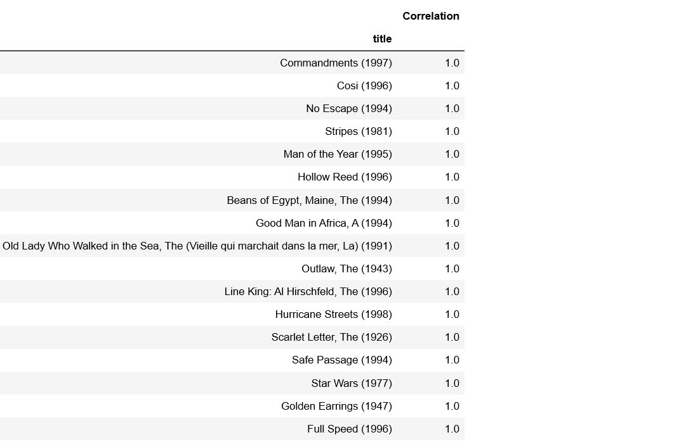
#Now the movie list is sort out based upon best match.
7.corr_starwars.sort_values(‘Correlation',ascending=False).head(20)

Slide 35

WEBSITE

Slide 36


Slide 37
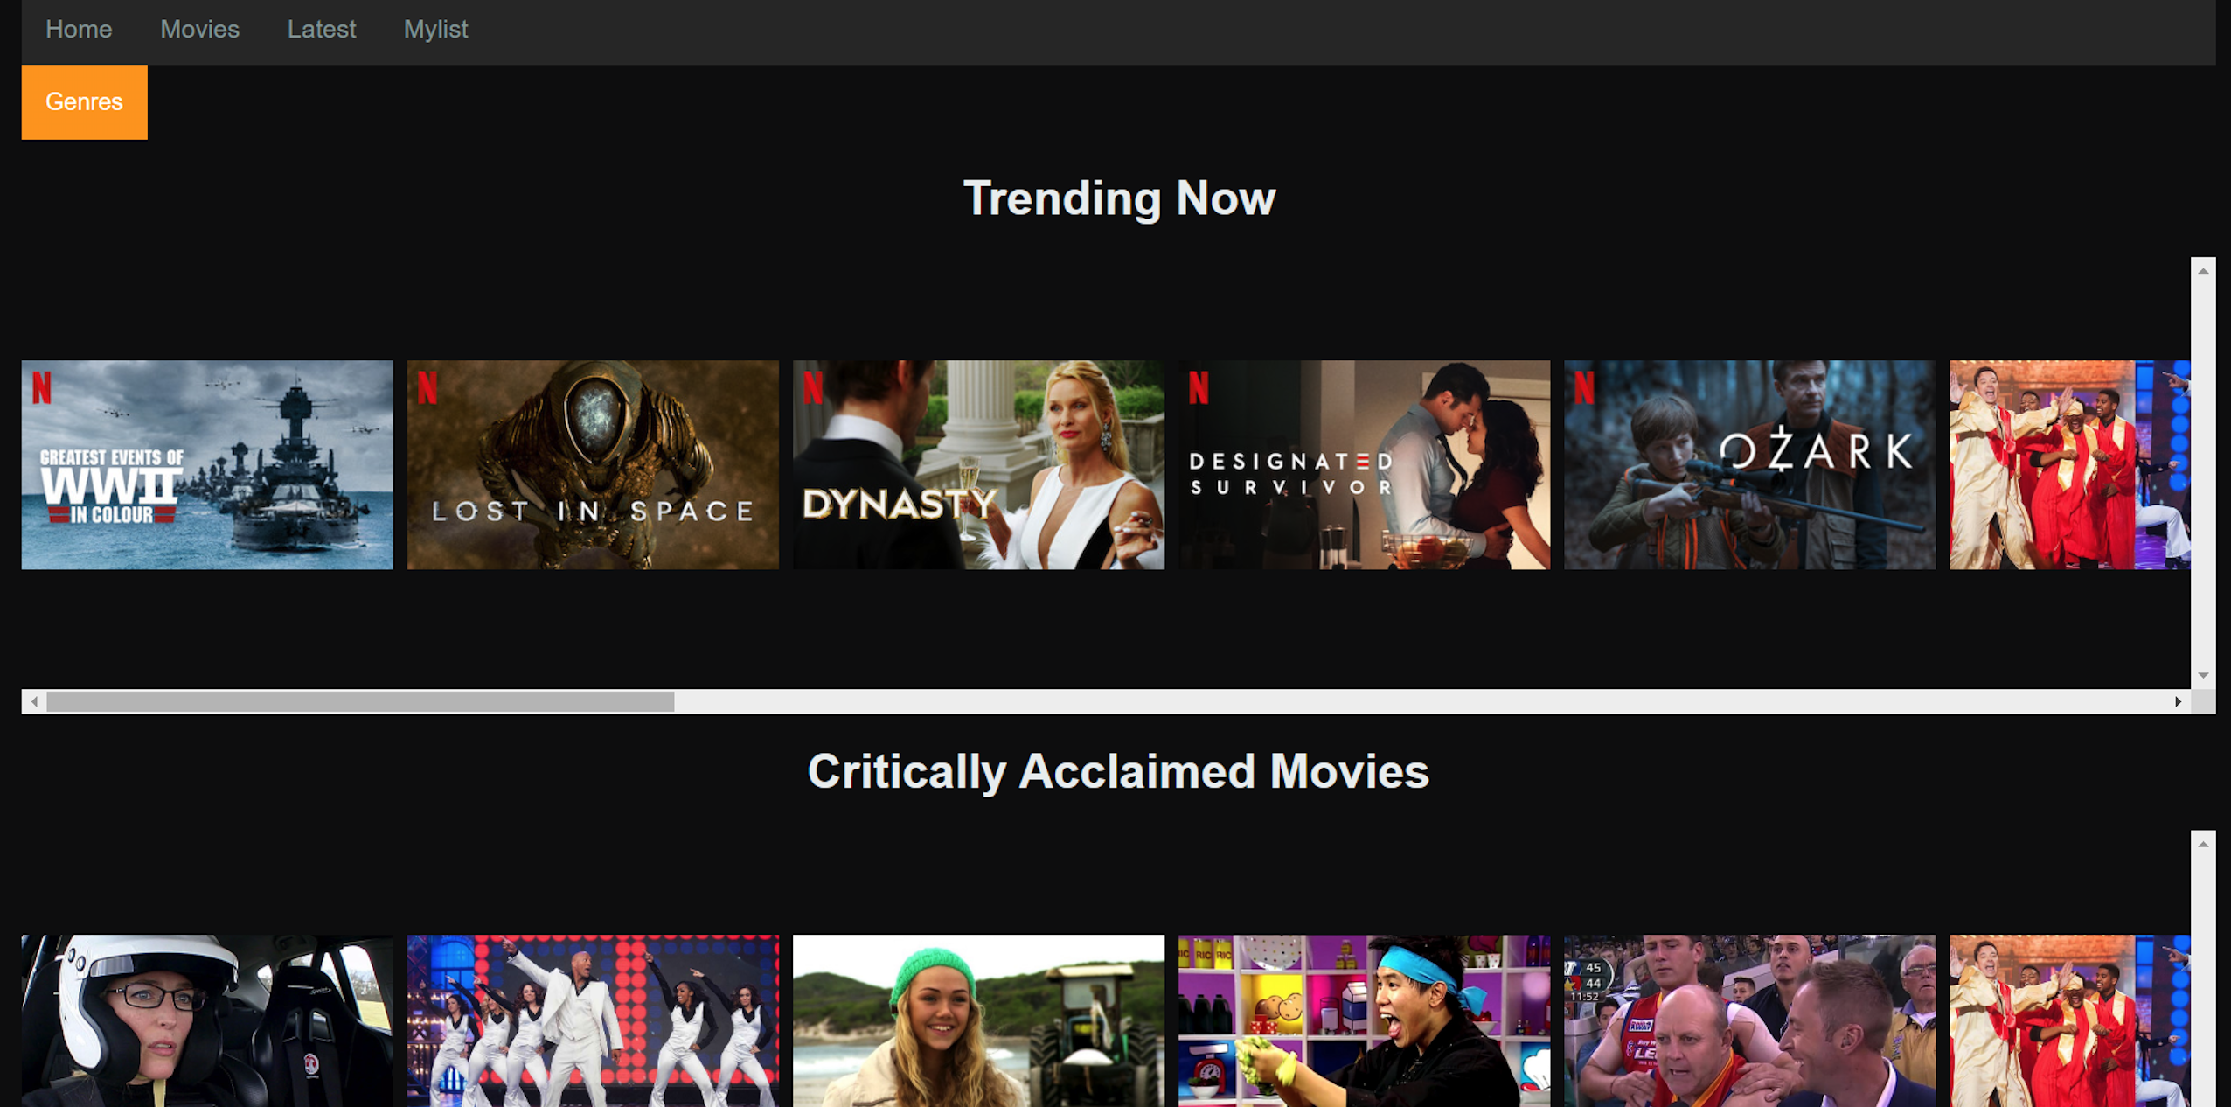

Slide 38
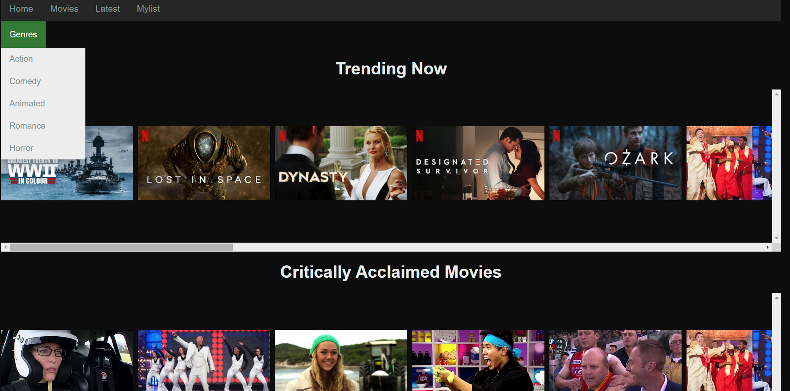

Slide 39
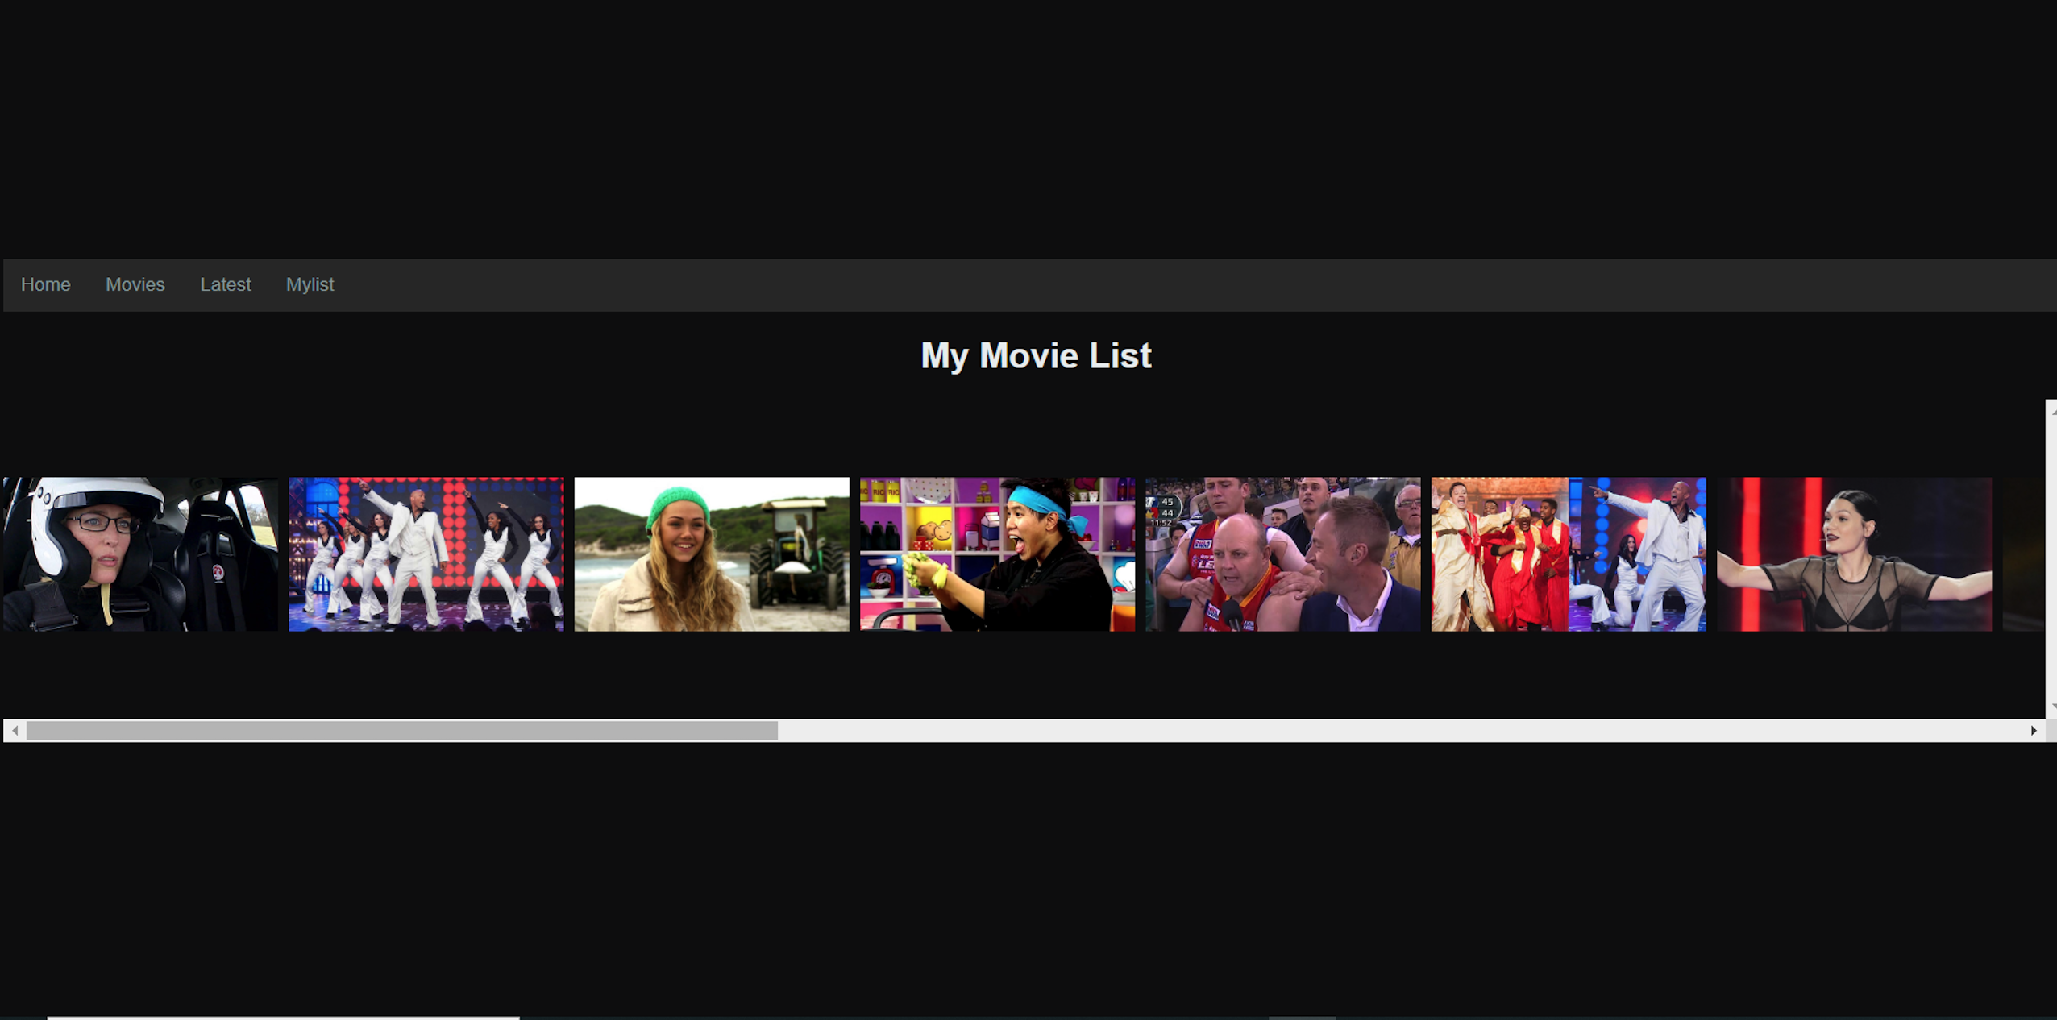

Slide 40
References
Yun, Youdong, Danial Hooshyar, Jaechoon Jo, and Heuiseok Lim. "Developing a hybrid collaborative filtering recommendation system with opinion mining on purchase review." Journal of Information Science 44,no. 3 (2018): 331-344.
Adomavicius, G., Sankaranarayanan, R., Sen, S., and Tuzhilin, A., 2005. Incorporating contextual information in recommender systems using a multidimensional approach. ACM TOIS, 23, 1, 103-145.
Cami, B. R., Hassanpour, H., & Mashayekhi, H. (2017). A content-based movie recommender system based on temporal user preferences. 2017 3rd Iranian Conference on Intelligent Systems and Signal Processing (ICSPIS).
International Journal of Scientific & Engineering Research, Volume 7, Issue 2, February-2017 ISSN 2229-5518

Slide 41
Conclusion
Recommendation systems are data filtering tools that make use of data, algorithmns, and different techniques to recommend the most relevant items to all kinds of users. They help users get personalized recommendations. They are an important tool in e-commerce sites. They are used in a variety of fields including movies, music, videos, books, online shopping, restsurants, news and various others. Netflix, Amazon Prime, Amazon Kindle, Twitter, Instagram, Youtube, Flipkart, Ebay are all recommendation systems. All social networking sites are recommendation systems. Movie recommendation systems help users decide which movies to watch instead of them wasting time deciding what to watch. The system implemented in our project is based on the collaborative filtering algorithm along with matrix factorization method. However, we have used opinion mining and clustering to incorporate the user's opinion at the fine-grained level to improve the prediction accuracy of recommendation system. They help overcome the problem of information overload. Movies are recommended to users based on the reviews, ratings, and feedback given by them. It depends on their previous interaction with the system. The goal is to provide the most accurate recommendations in the least possible time.

